Slide 1



UNIT 5; Healthy and green
Childline

Slide 2
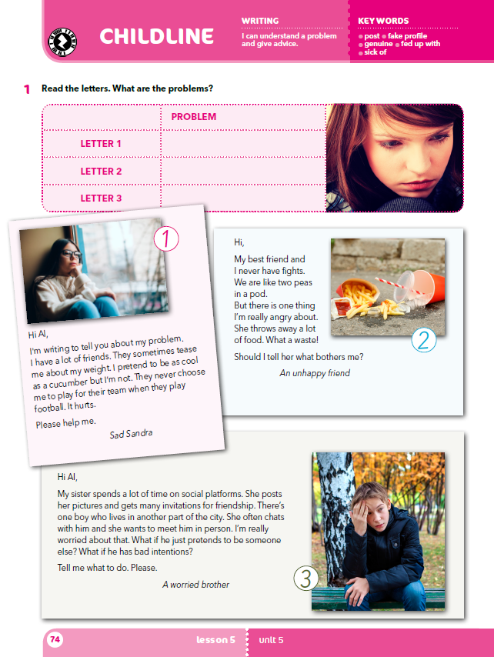
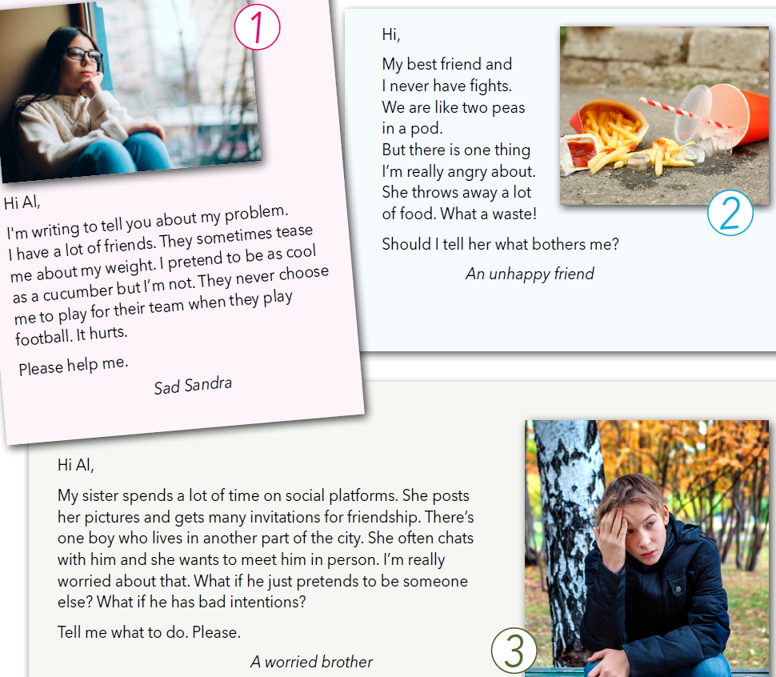
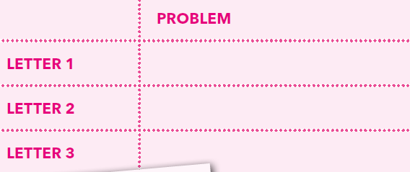
What do you most often think about?
Do you sometimes think about things that make you worried or unhappy?
What usually bothers you and your friends?
Do you talk about it?
Can you share it with your parents, grandparents, teachers, or someone else?
Do you sometimes write about those problems?
Do you sometimes read problem letters in youth magazines?
Do you like the answers to the letters?
Have you ever sent such a letter to a magazine?
Read the letters.
What are the problems?
Her friends tease her about her weight.
Her friend throws away a lot of food.
His sister spends a lot of time chatting online.

Slide 3
What is the Unhappy friend fed up with?
Which sport do Sandra’s friends play?
Has Sandra got a lot of good friends?
Why is the worried brother concerned with his sister’s posts?
Does he believe that all people on social platforms are genuine?
Think about the solutions for their problems!

Slide 4
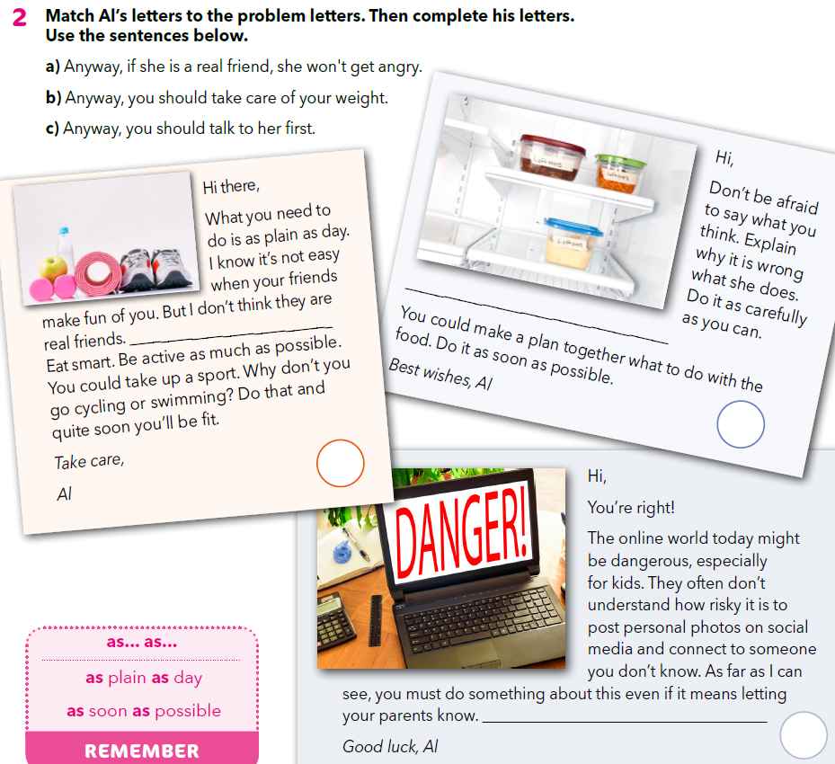
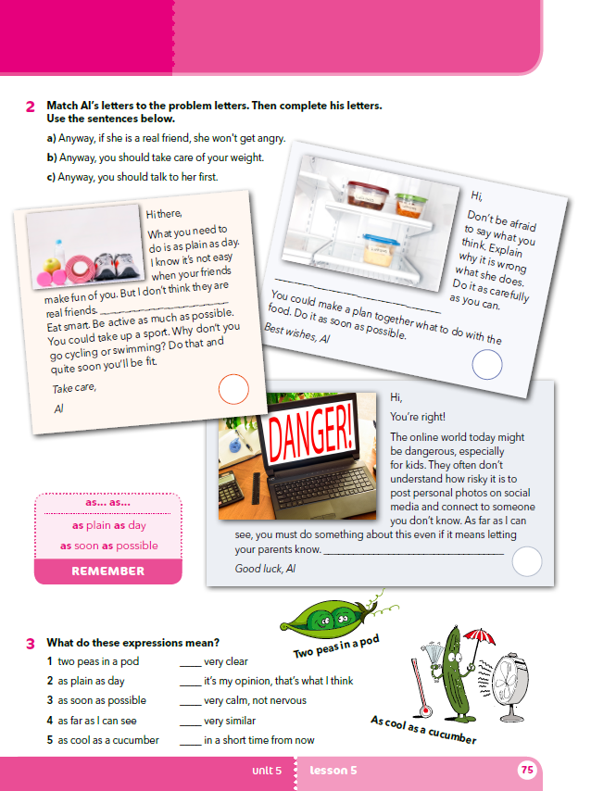
On the next page...
Match Al’s letters to the problem letters. Then complete his letters.
Use the sentences below.
a
b
2
1
c
3

Slide 5
What can Sandra do to feel better?
Should she choose friends more wisely?
Should friends be totally honest with each other?
Does being honest mean you should not pay attention to person’s feelings?
How can the Unhappy friend help her/his friend with leftovers?
What does Al think about posting personal photos?
Is it safe to meet online friends in person?
Is it difficult to make a fake profile? Do you know anyone who has made a fake profile?
Napiši i ti jedno kratko pismo u kojem izlažeš stvarni ili zamišljeni problem i traži savjet.
a
b
2
1
c
3

Slide 6

Practise: https://wordwall.net/play/918/956/874
What are the children writing about?
Who are they writing to?
Which problems do they have?
What are the pieces of advice Al gives them?
How does the Unhappy friend feel with her/ his best friend?
What is the expression she/he uses for the two of them?
What does Sandra pretend to be like when her friends ignore or tease her?
What is the expression Al uses when he wants to say that something is obvious, easy to understand, not complicated, plain and simple?
What does a.s.a.p. mean?
How does Al tell the worried brother that he believes the brother should take an action about the sister’s plan?

Slide 7

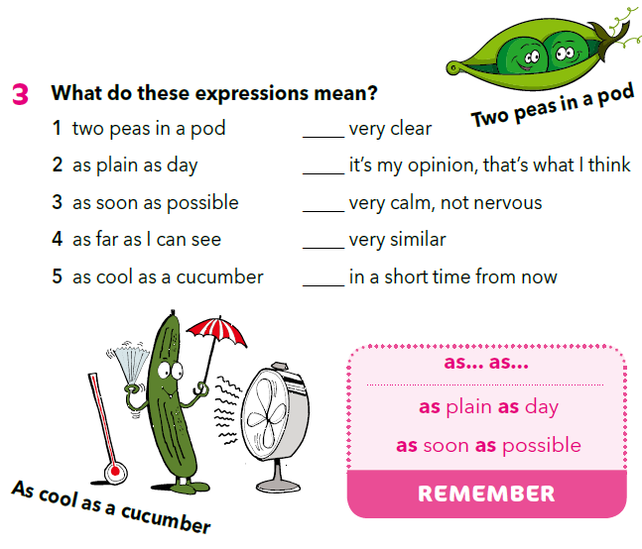
2
4
5
1
3
Pokušaj pročitati Alove savjete koristeći se sinonimnim izrazima iz 3. zadatka!

Slide 8
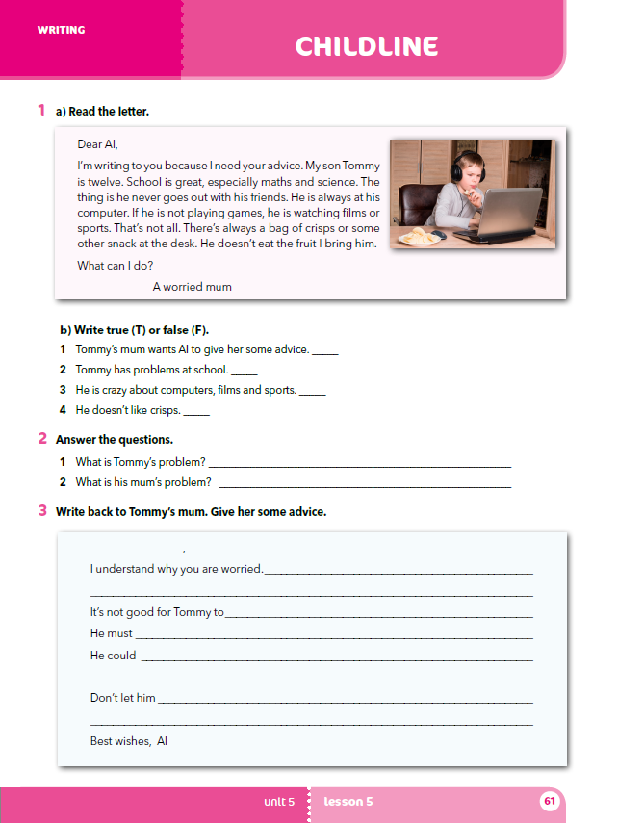
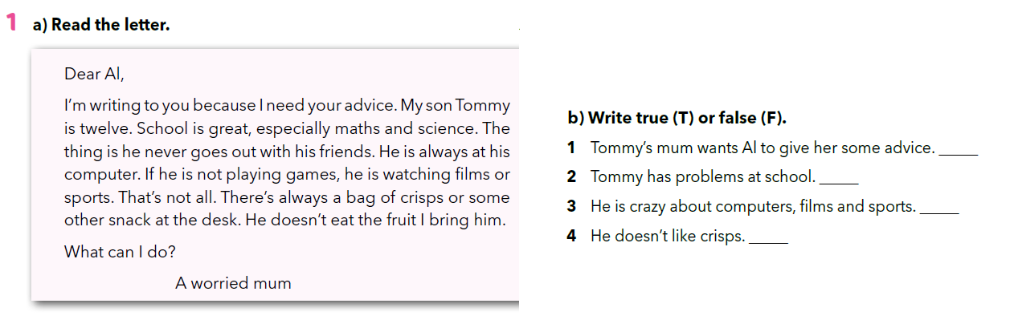
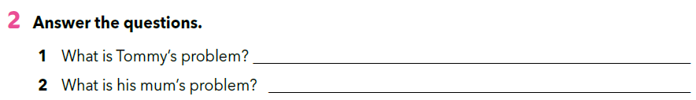
Workbook, p. 61
Read the letter and then write true (T) or false (F).
T
F
T
F
Answer the questions.
Tommy doesn’t socialize and eats unhealthily.
His mum would like to help him change that.

Slide 9

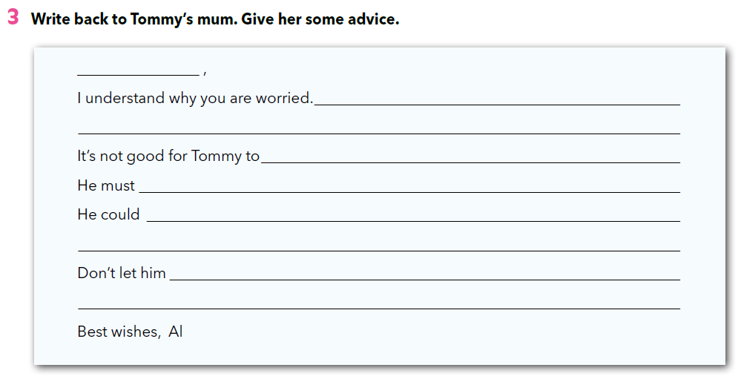
Write back to Tommy’s mum. Give her some advice.

Slide 10

LEARN MORE
https://www.e-sfera.hr/dodatni-digitalni-sadrzaji/16960709-ba73-413e-9361-b4cfef050429/
Top ten strange food people eat

